Slide 1

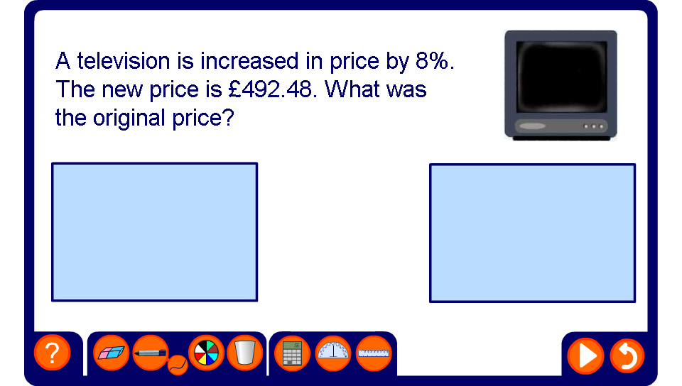


Reverse percentages
Notes:
Talk through as many examples as necessary.

